Slide 1
E-commerce Data Analysis - Trends and Customer Sentiment - Logiya Vidhyapathi 17/07/2024

Slide 2
Introduction
The aim of the project is to explore insights derived from over 1,000 Amazon products, focusing on their performance and customer feedback. Our objectives are to:
Analyze product categories and their popularity.
Investigate pricing strategies and discounts.
Explore customer sentiments through reviews and ratings.
Provide actionable insights for enhancing product offerings and customer satisfaction.

Slide 3
Dataset Overview
Comprehensive insights from 1,457 rows and 15 columns of Amazon product data.
Key features include:
Product Details: ID, name, category, discounted price, actual price, discount percentage, description, image link, and product link.
Rating Information: Rating score and the number of votes.
Review Information: User ID, user name, review ID, review title, and review content.
Provides in-depth analysis opportunities for product performance and customer feedback.“
Business Question:
How do customer sentiments and review ratings influence the purchasing decisions and discount strategies for different product categories on Amazon?

Slide 4
Exploratory Data Analysis
Dropping Columns
Replacing Values
Converting DataType
Converting discount percentage into decimal form
Checking Null Values
Retrieving the Null Values Row
Rating and Rating Count Mean and Median Values
Replacing Null Values with Median Value
Categorize the values in the Rating column
Calculate the price difference between the actual_price and the discounted_price

Slide 5
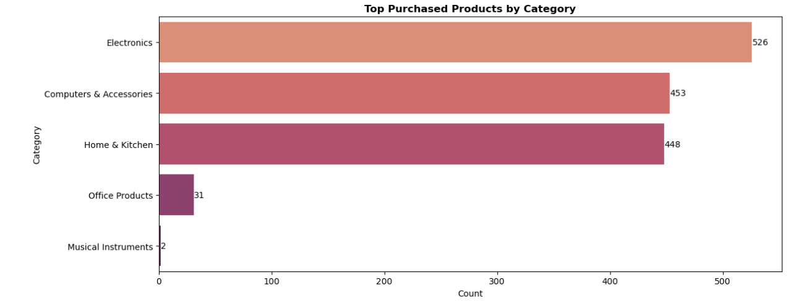
Bar Plot Top Purchased Products by Category
The bar plot shows the top purchased products by category. Electronics is the most purchased category, followed by Computer & Accessories. This indicates that these two categories are the most popular among customers compared to other categories.

Slide 6
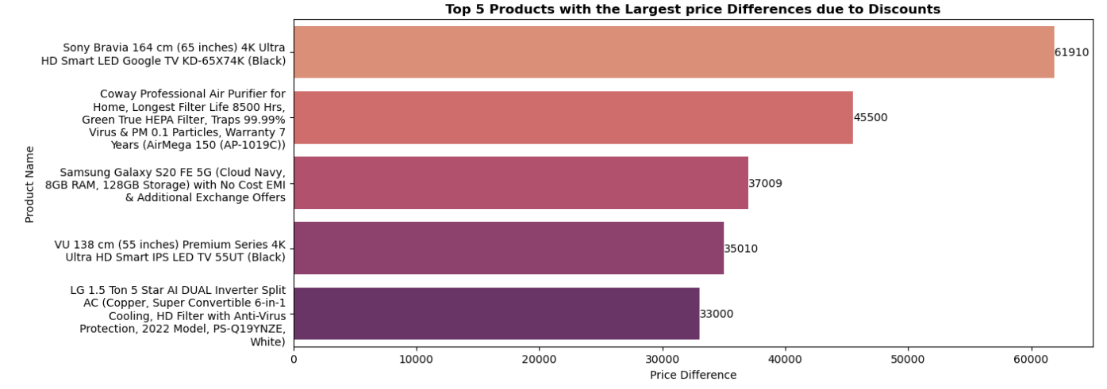
Top 5 Products with the Largest Price Differences due to Discounts
The bar plot displays the top 5 products with the largest price differences due to discounts. Sony Bravia 164 4K Ultra HD Smart LED Google TV has the greatest price difference at 61910 after the discount, followed by Coway Professional Air Purifier at 45,500. This indicates that these two products have the largest price differences due to discounts compared to the other three products.

Slide 7
Sentiment Analysis
Sentiment analysis is the process of determining the sentiment or emotional tone behind a piece of text. It involves analyzing words or phrases to understand whether the expressed opinion is positive, negative, or neutral. This technique is commonly used in natural language processing and text mining to gauge public opinion, customer feedback, or social media sentiment about a particular topic, product, or event. I will import two libraries for Sentiment Analysis:
wordcloud
Textblob
WordCloud visualizes the most frequent words in text data, while TextBlob analyzes sentiment by assessing the polarity and subjectivity of text.

Slide 8
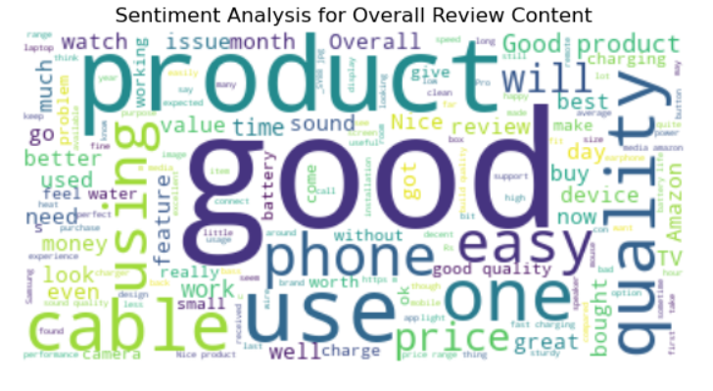
Sentiment Analysis of Overall Review
The sentiment analysis for overall reviews shows customers express positive sentiments like ‘good’, ‘best’ and ‘look’ indicating widespread satisfaction with product quality and usability. However, terms such as ‘poor’, ‘low’, ‘slow’ and ‘bad’ also appear, suggesting areas for improvement in product reliability and customer service. This visualization captures diverse customer feedback, highlighting both strengths and areas needing enhancement.

Slide 9
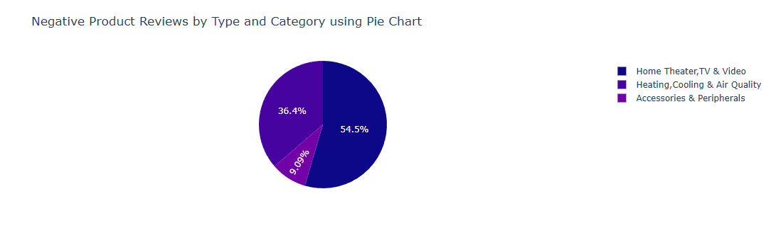
Negative Product Reviews by Type and Category using Pie Chart
Home, Theater, TV and Video: This product type accounted for the highest percentage of negative reviews at 54.5%, indicating common issues or dissatisfaction with these products.
Heating, Cooling & Air Quality: This product type represented the 36.4% of negative reviews, suggesting areas where customers experience disappointment or dissatisfaction.
Accessories & Peripheral: This product type represented the remaining 9.09% of negative reviews, indicating specific areas that may require attention or improvement based on customer feedback.

Slide 10
Statistical Analysis
Statistical analysis involves using mathematical techniques to analyze data. Its purpose is to uncover patterns, relationships, or trends within the data, which can then be used to make decisions or draw conclusions. It helps in summarizing data, testing hypotheses, and making predictions based on the information available.
In this analysis, we have utilized the following statistical tests,
Two-way ANOVA
Independent t-test
Chi-square test.
These tests were used to explore relationships, differences, and dependencies within the dataset, aiding in drawing meaningful conclusions from the data.

Slide 11
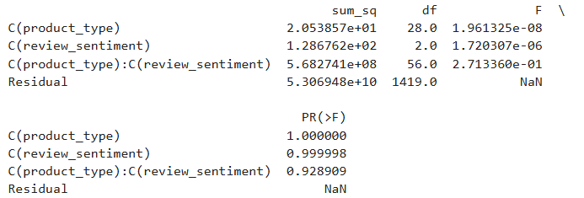
Two-way ANOVA
The Two-way ANOVA results indicate that there are no statistically significant interactions between product types and review sentiments on discounted prices.

Slide 12
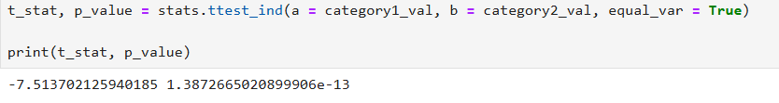
Independent t-test
The independent t-test conducted here compares the mean discounted prices between two categories, "Computers & Accessories" and "Home & Kitchen.“
Reject the Null Hypothesis at alpha 0.05.

Slide 13
Conclusion
The data analysis offers valuable insights into product performance, customer sentiment, and pricing strategies across various categories. Key findings include:
Customer Sentiment Analysis: Positive sentiment dominates across most product categories, highlighting strengths in product quality and customer satisfaction.
Pricing Strategy Impact: Products with higher initial prices tend to receive more significant discounts, influencing customer purchasing decisions.
Customer Engagement Opportunities: Leveraging customer feedback for product improvement and enhancing overall shopping experience.

Slide 14
Future Enhancements
Implementing machine learning for real-time data analysis can enhance decision-making and customer experience by:
Real-time Personalization: Using machine learning algorithms to analyze real-time data streams enables personalized product recommendations and targeted marketing campaigns.
Predictive Analytics: Leveraging predictive models to forecast customer preferences and trends, optimizing inventory management and pricing strategies.

Slide 15
Thank you

